Slide 1
Templates
Unit-07

Slide 2
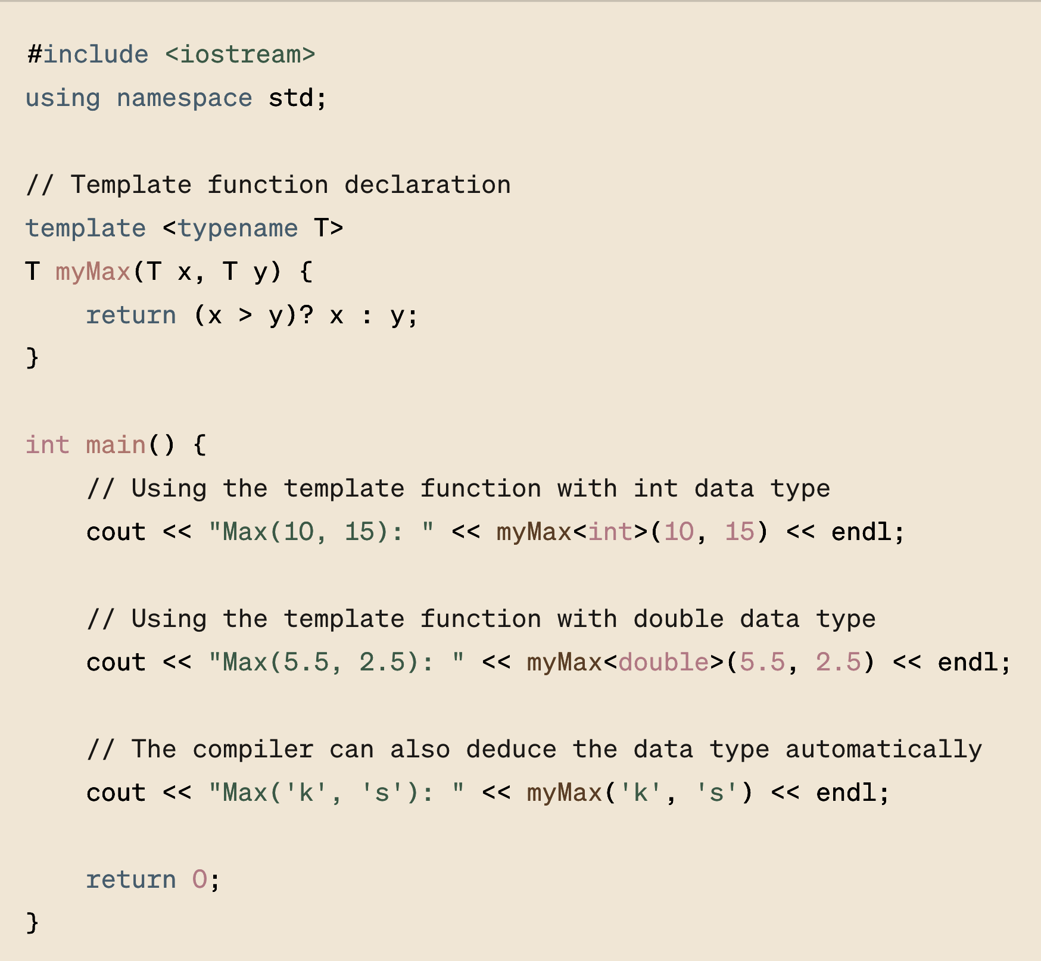
In this example:
template <typename T> is the template parameter declaration.
T myMax(T x, T y) defines a function myMax that takes two parameters of type T and returns a value of type T.
Note that in some cases, you do not need to explicitly specify the type (like for myMax('k', 's')) because the compiler can deduce the type based on the arguments passed to the function.
Template functions are powerful and flexible, making them a fundamental feature of C++ that supports generic programming.

Slide 3
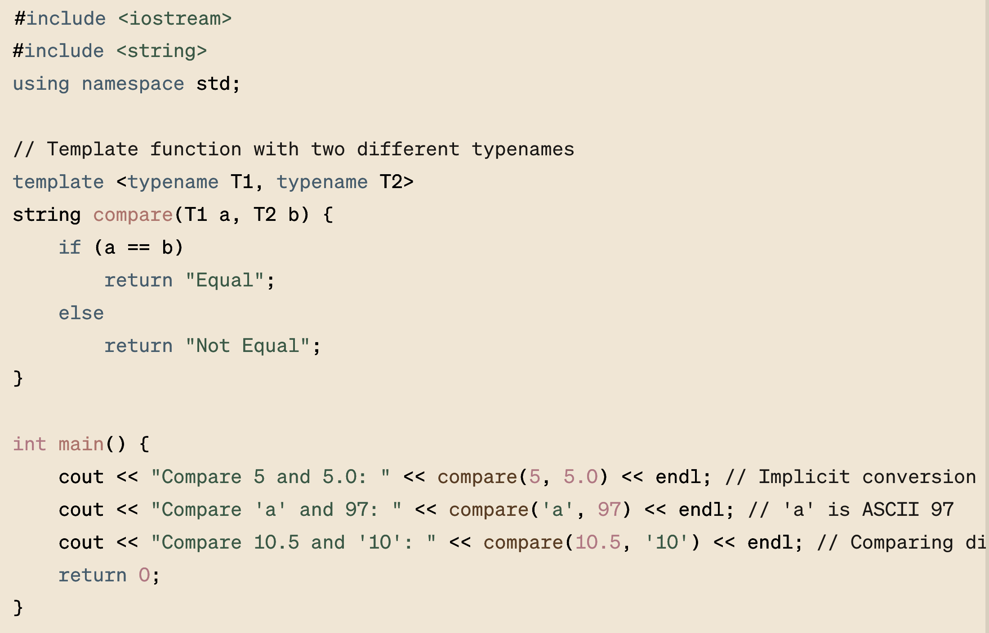
What is happening here?

Slide 4
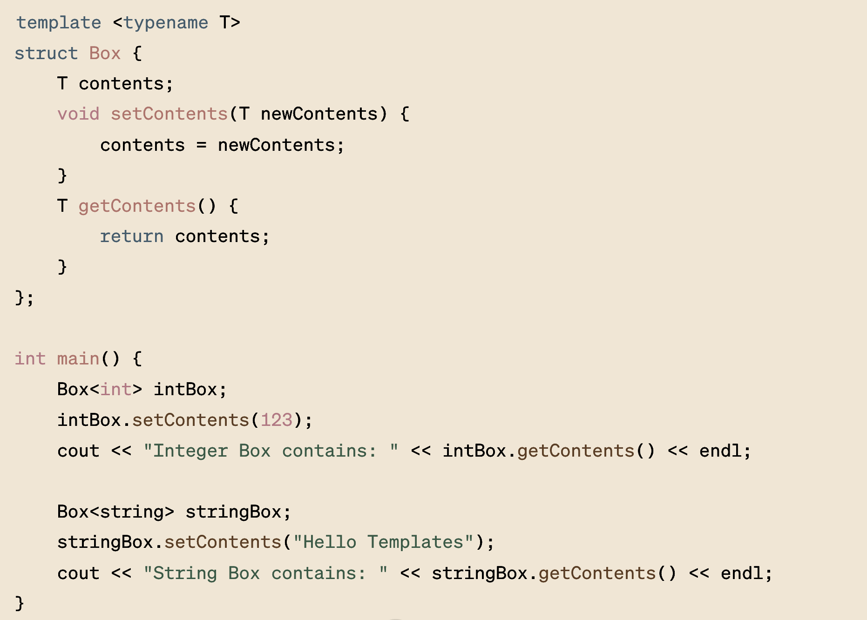

Slide 5
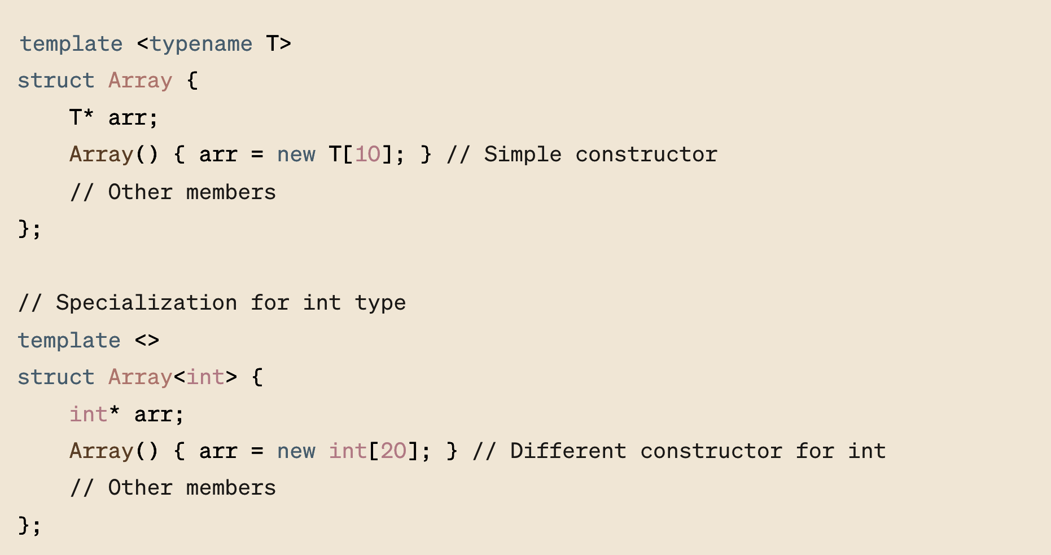
Template Specialization

Slide 6
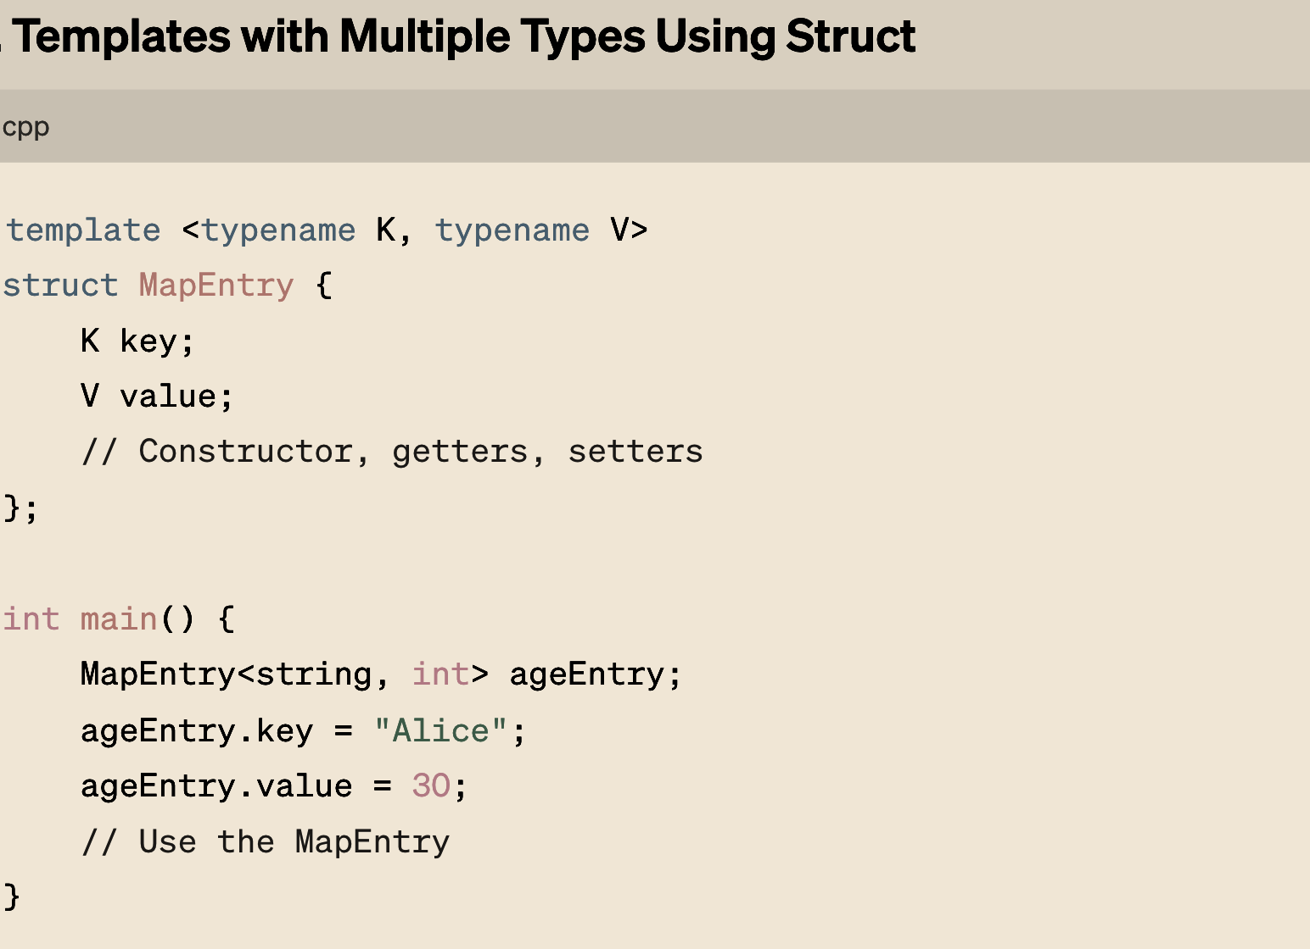

Slide 7
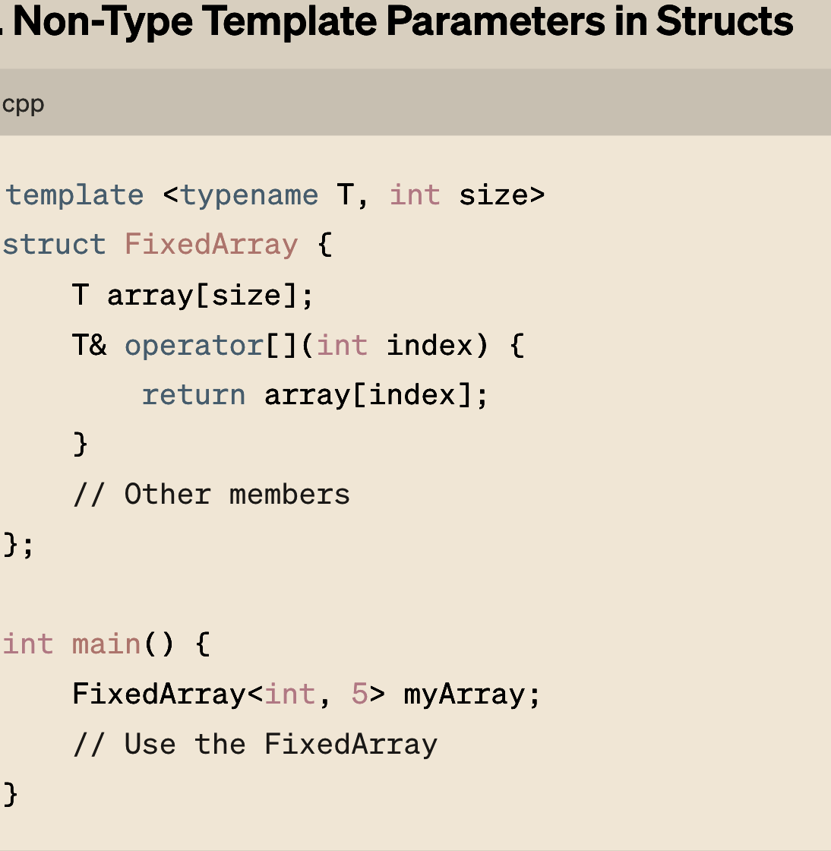

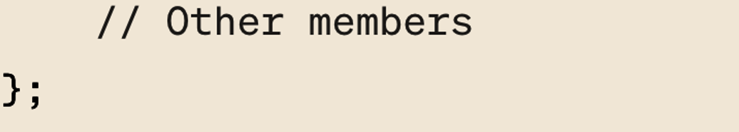
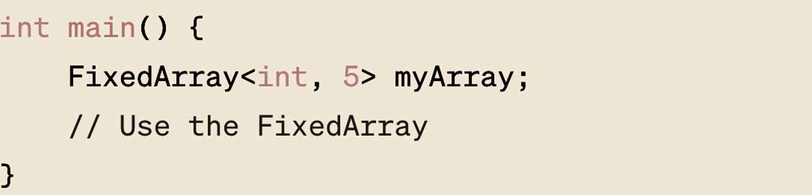
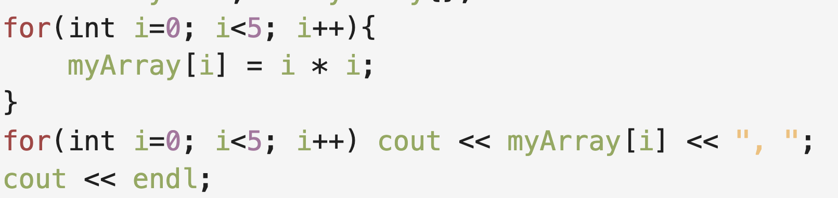
Non-type template parameters in C++ templates allow you to pass values, not just types, to your templates. This feature enables templates to be more flexible and powerful, as you can define behavior not just based on types but also on certain compile-time constants or other value-based parameters. These parameters can be integral types (like int, unsigned, size_t), pointers, references, or even user-defined constexpr objects that have a constant value at compile time.
Can you find a bug…?

Slide 8
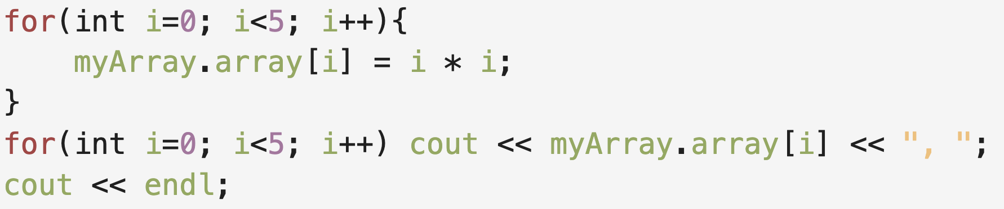
Non-type template parameters in C++ templates allow you to pass values, not just types, to your templates. This feature enables templates to be more flexible and powerful, as you can define behavior not just based on types but also on certain compile-time constants or other value-based parameters. These parameters can be integral types (like int, unsigned, size_t), pointers, references, or even user-defined constexpr objects that have a constant value at compile time.

Slide 9
Non-type template parameters in C++ templates allow you to pass values, not just types, to your templates. This feature enables templates to be more flexible and powerful, as you can define behavior not just based on types but also on certain compile-time constants or other value-based parameters. These parameters can be integral types (like int, unsigned, size_t), pointers, references, or even user-defined constexpr objects that have a constant value at compile time.

Slide 10
Non-type template parameters in C++ templates allow you to pass values, not just types, to your templates. This feature enables templates to be more flexible and powerful, as you can define behavior not just based on types but also on certain compile-time constants or other value-based parameters. These parameters can be integral types (like int, unsigned, size_t), pointers, references, or even user-defined constexpr objects that have a constant value at compile time.

Slide 11
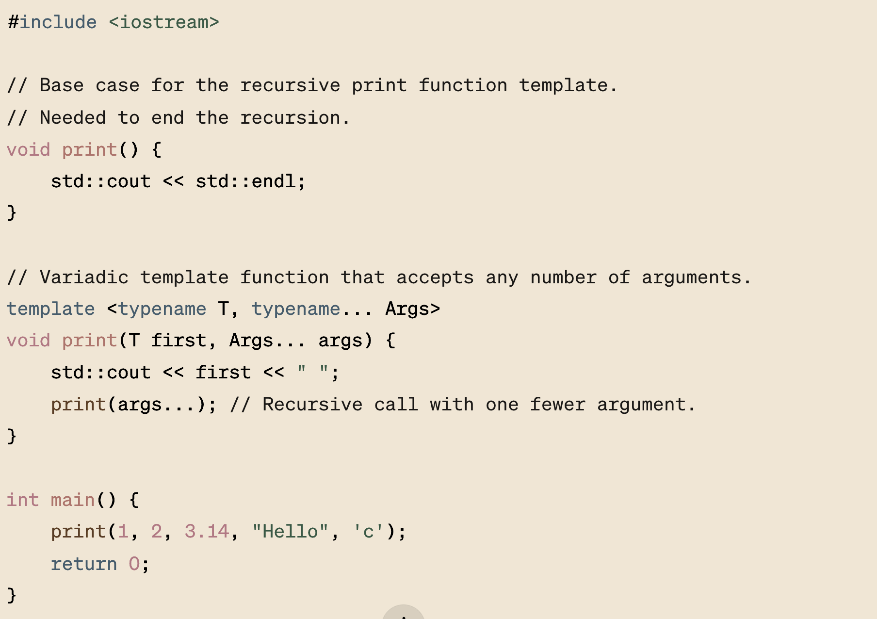
Variadic Template

